Slide 1
Product Inspector analyzes Indian consumer goods for FSSAI compliance, nutritional impact, and additive safety
CAPSTONE PROJECT
Presented By:
Student Name- Sagar Santosh Padvalkar
College Name- Dnyanprasarak Mandal’s College and Research Center
Department- TYBcom (Banking and Financial sevices)
4. AICTE ID-STU69f35e36c47231777557046

Slide 2
OUTLINE
Problem Statement
Proposed System/Solution
System Development Approach
Algorithm & Deployment
Result
Conclusion
Future Scope
References

Slide 3
Problem Statement
India’s food safety ecosystem suffers from a critical enforcement deficit, poor hygiene infrastructure, and a fragmented supply chain, exposing over 1.4 billion consumers to widespread microbial contamination, toxic pesticide residues, and economic food fraud. This regulatory gap is further widened by a severe shortage of food safety inspectors and the rapid, unchecked growth of digital cloud kitchens and quick-commerce delivery apps. Consequently, this crisis results in over 100 million annual cases of foodborne illness, creating a double burden of preventable public health crises and billions of dollars in lost economic productivity.

Slide 4
Proposed Solution
This platform provides significant public value by increasing food transparency, empowering consumers to make healthier choices, and making complex nutritional and regulatory data accessible.
Key Public Benefits
Promotes Health Literacy & Transparency: Translates dense nutritional labels, FSSAI regulations, and technical ingredients into clear health ratings (like Nutri-Score and Clean Label scores). Consumers can immediately identify hidden saturated fats, sodium, or artificial additives.
Simplifies Informed Purchasing: Helps individuals quickly assess whether a product fits their personal goals, health conditions (e.g., cardiovascular risks), or specific dietary requirements (such as Gluten-Free, Jain, or Vegan compliance).
Demystifies Food Processing: Categorizes foods using standard frameworks (like the NOVA Group classification) and details industrial manufacturing pipelines so users understand how heavily processed a product is before buying.
Encourages Better Alternatives: Suggests healthier local swaps and offers economic breakdowns (e.g., cost per serving), aiding consumers in finding better nutritional value within their budget.
Supports Regulatory Standards: Highlights official certifications (such as FSSAI and Agmark) and flags harmful additives, helping hold brands accountable to local quality standards.

Slide 5
System Approach
Technologies Used
Streamlit
Python
Uv
GNU Make
Gemini Api key
Input Feature
An option selector to switch between the three Input Modes: Barcode / Indian Brand or Product Name, Popular Indian Sample, Product Image Upload
A menu to choose from a list of predefined Popular Indian Sample products (such as Amul Butter, Maggi Noodles, Parle-G, Cadbury Silk, and Tata Salt).
An upload widget allowing users to select and send physical Product Images
Output : Tell all detail of the product like price, safe or unsafe, Nutri-Score, Processing Level and many more details

Slide 6
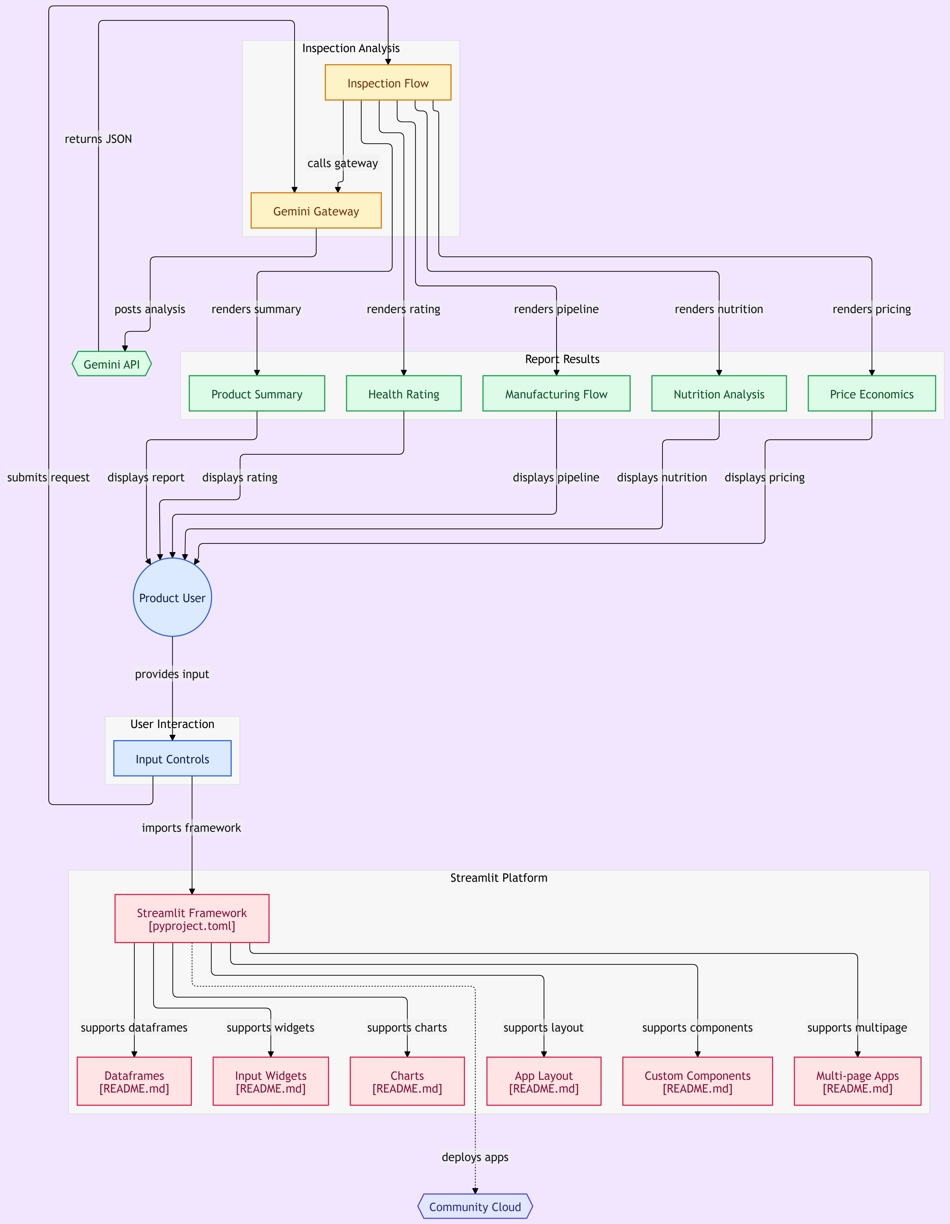
Algorithm & Deployment
Deployment: Streamlit- based web application.

Slide 7
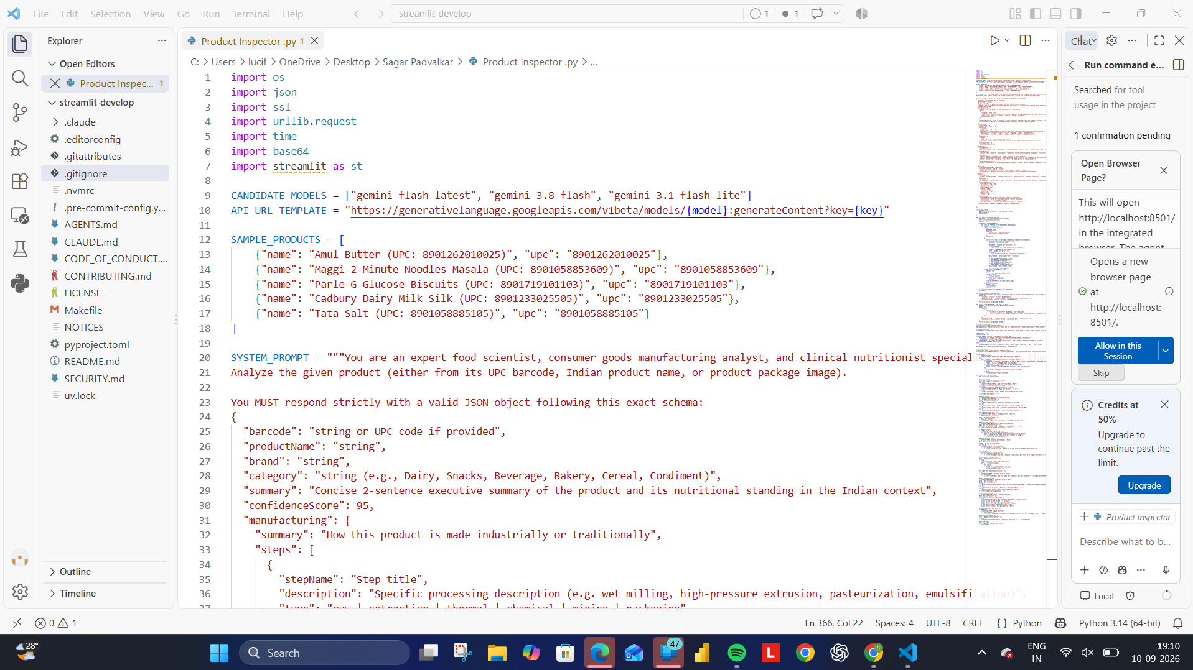
Result

Slide 8
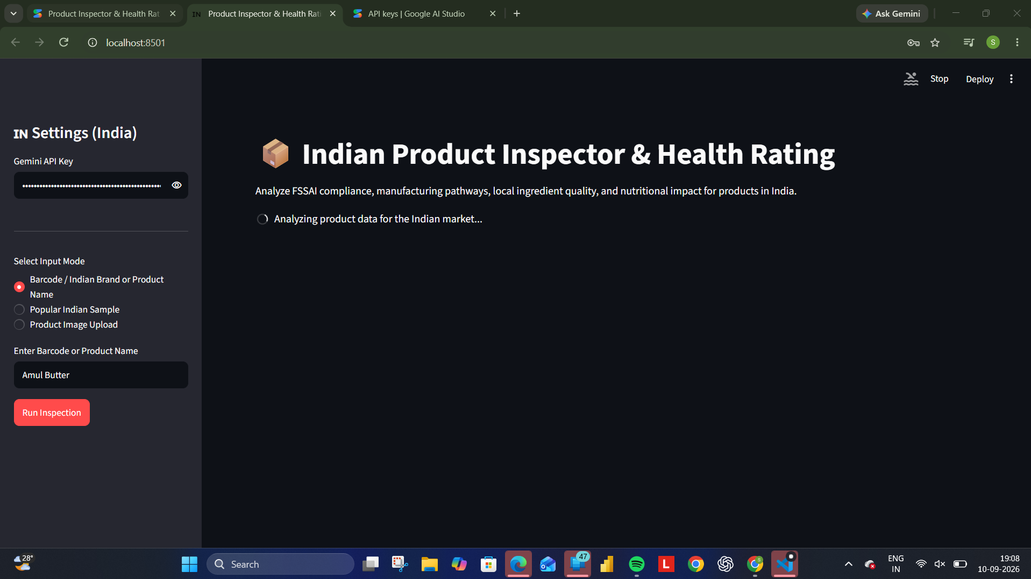

Slide 9
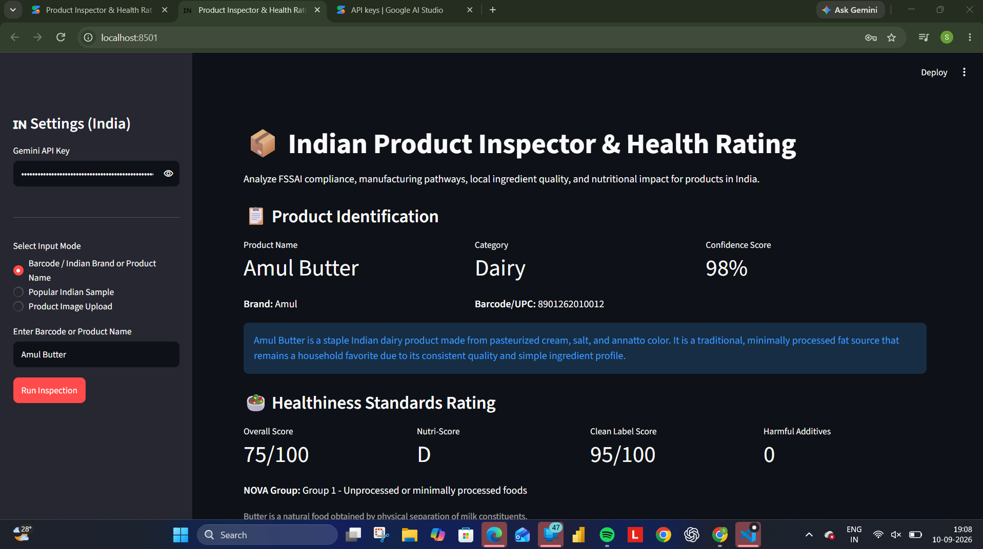

Slide 10
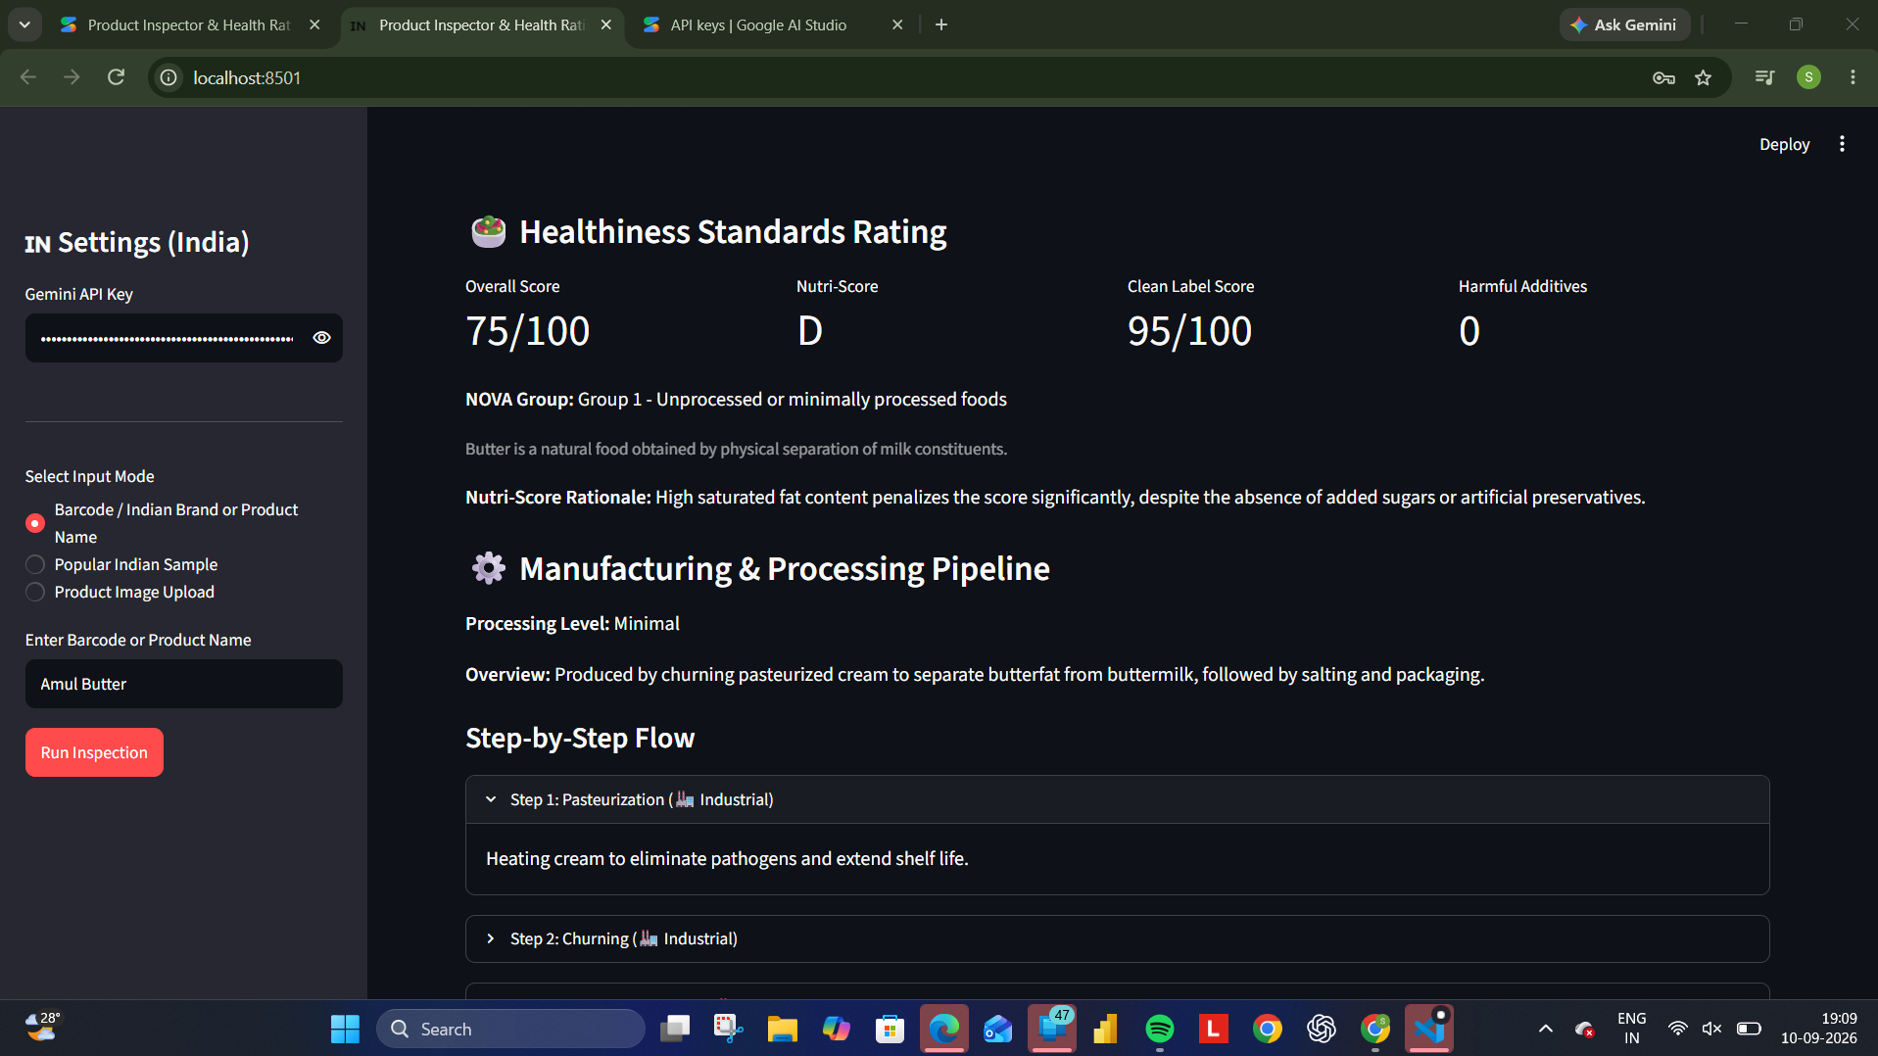

Slide 11
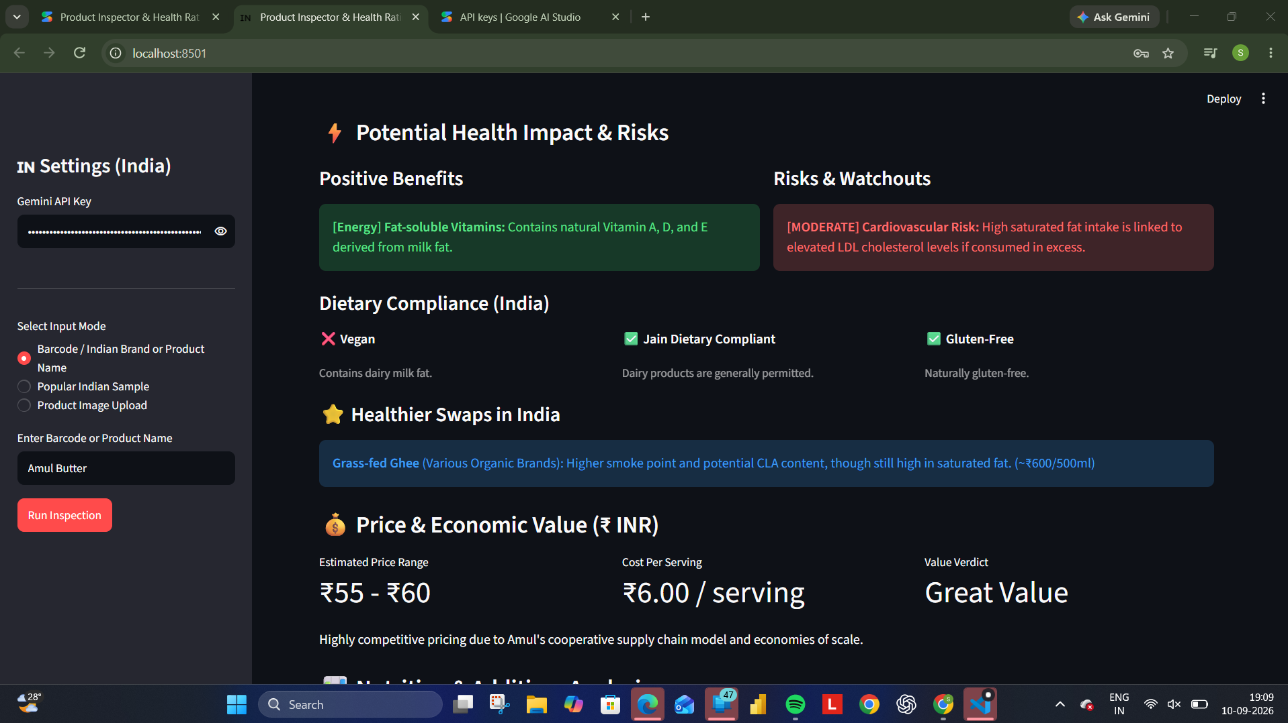

Slide 12
Conclusion
This application Indian Product Inspector & Health Rating analyzes Indian consumer goods for FSSAI compliance, nutritional impact, and additive safety. Users input product names, barcodes, or images to view detailed health scores (Nutri-Score, NOVA group), step-by-step manufacturing pathways, dietary compliance, and healthier local swaps.
Key Outcomes:
Comprehensive Health Scoring: Instantly evaluate food products using standardized systems like Nutri-Score and NOVA group classifications for ingredient and processing quality.
FSSAI Compliance & Safety Checks: Identify additive safety, regulatory compliance, and potential harmful ingredients in consumer products.
Actionable Swaps & Recommendations: Discover healthier local alternatives tailored to dietary needs and personal health goals.
Transparency into Manufacturing: Understand the step-by-step production pathway and ingredient sourcing of analyzed products.

Slide 13
Future scope
For the general public, the future scope of the Indian Product Inspector & Health Rating platform centers on empowering consumers to make healthier, safer, and more conscious choices.
Key practical expansions include:
Mobile App Integration: Direct camera scanning to read barcodes and ingredient labels instantly in grocery store aisles.
Personalized Health Profiles: Customizing ratings based on individual needs—such as flagging high sodium for hypertension, high sugar for diabetes, or strict allergen alerts (e.g., lactose, gluten, nuts).
Crowdsourced Database: Allowing users to submit local Indian products, rural regional brands, and missing items to build a comprehensive public dataset.
Additives & Chemical Decoders: Deep-dive breakdowns of INS numbers, preservatives, and artificial colors to inform consumers about hidden chemical risks.
Cleaner Alternative Finder: Automatic recommendations for healthier local swaps, organic brands, or traditional Indian alternatives for heavily processed snacks.
FSSAI Compliance Tracking: Highlighting mismatches between packaging claims (like "100% Natural" or "No Added Sugar") and the actual ingredient list.

Slide 14
References
Python 3.14.7
Fssai data
Streamlit
Google ai studio
Github

Slide 15
Deployment link / github link
Github Link: https://github.com/padvalkarsagar31-debug/Product_Inspector-.git

Slide 16
THANK YOU

